Slide 1
The Future of Work from a Real Property
Perspective

Slide 2



Welcome
Paul Thompson
Deputy Minister
Public Services and Procurement Canada, Government of Canada
Stéphan Déry
Assistant Deputy Minister
Real Property Services
Public Services and Procurement Canada, Government of Canada

Slide 3

Today’s agenda
A changing global environment
The hybrid model
  GcWorkplace
  Office Long Term Plan
  Hub and spoke model
Aligning the hybrid model with the Government’s priorities
  Greening
  Accessibility
  Reconciliation
Questions

Slide 4

A changing global environment

Slide 5


A global shift
  We are shifting into a worker-centric world, in which successful organizations will be those who put "people first";
  Real estate needs are becoming more sophisticated and complex, and investing in quality space will be a greater priority than expanding total footprint;
  Environmental and social aspirations will shape future portfolio transformation;
  Intelligent technology investments are greater and needed more than ever.
Source: JLL Future of Work Global Survey, March 2022

Slide 6
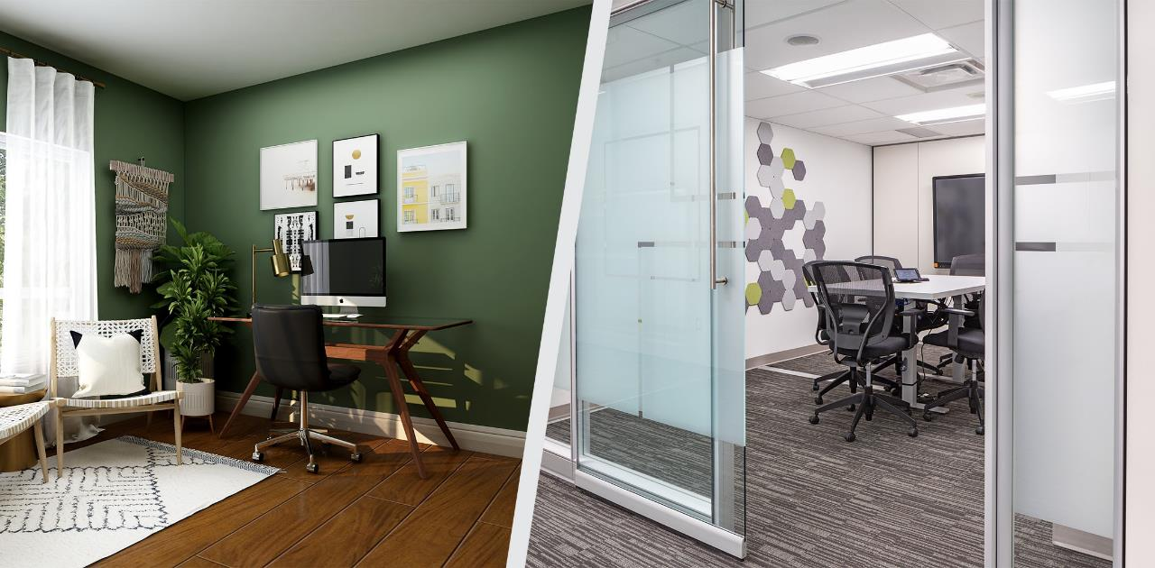

The post-pandemic reality
“Hybrid work is here to stay.”
The Honourable Mona Fortier, Treasury Board President

Slide 7
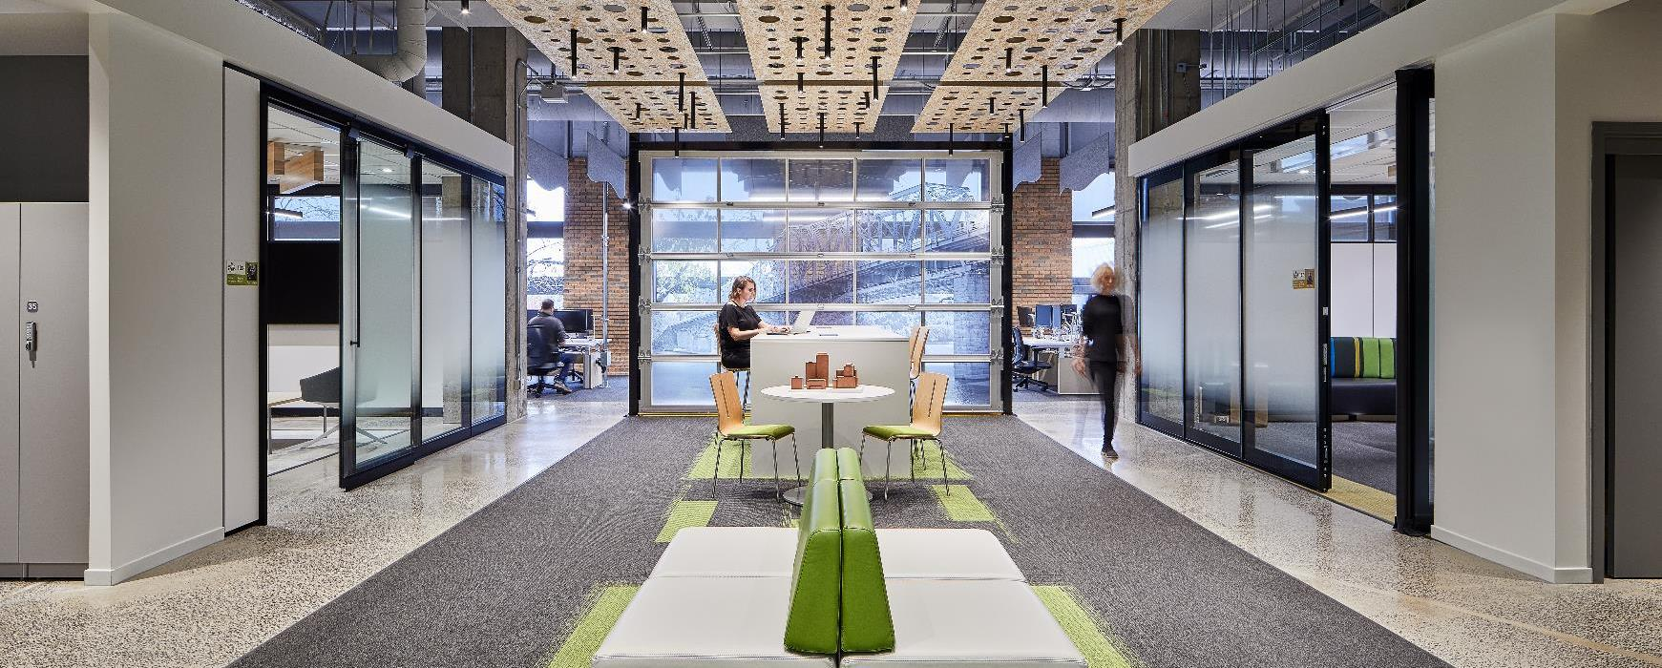
Meanwhile at PSPC

Slide 8

The Hybrid Model
There is not a ‘one-size-fits-all’ solution for the variety of work functions across the Government of Canada.
The implementation of a hybrid model allows for a combination of telework and the occupation of different workplaces, in a balanced way and according to employees’ realities.
While PSPC, departments, and agencies plan and work toward returning to the workplace, we are also identifying opportunities and developing longer term plans and strategies to implement the hybrid model.

Slide 9




Hybrid Model / GCWorkplace vision
Work is an activity, not a place
GCworkplace allows employees to experience the benefits of working together, such as developing healthy and solid relationships and team cohesion, mutual knowledge and experiences, brainstorming, or welcoming new employees into our teams.
GCcoworking workspaces enable employees to work from a common workspace as an alternative to their homes or to their usual central workplace locations, or as a touchdown point between meetings.

Slide 10


Hybrid Model: Office Long Term Plan / Hub and Spoke model
  The Office Long Term Plan (OLTP) guides PSPC efforts toward a modern office portfolio with optimal usage, high performance, and positive employee experience while delivering on Government of Canada priorities.
  To help achieve a significant portfolio reduction, a restacking exercise using the ‘Hub and Spoke Model’ is being completed in the National Capital Area.
There is not a ‘one-size-fits-all’ solution for the variety of work functions across the GC. PSPC’s strategy must deliver on government outcomes while balancing the diverse needs of Departments and employees.​
GCCOWORKING
NEIGHBOURHOODS
HUBS
HOMES

Slide 11

Aligning the hybrid model with the Government’s priorities

Slide 12

Greening initiatives
We are taking a leadership position by considering decarbonization into the design and approval stages of proposed projects.
We are encouraging the adoption of clean energy, and reducing energy use and carbon emissions in our buildings.
Highlight:
PSPC’s District Energy System is expected to reduce greenhouse gas emissions by 92% by 2025

Slide 13
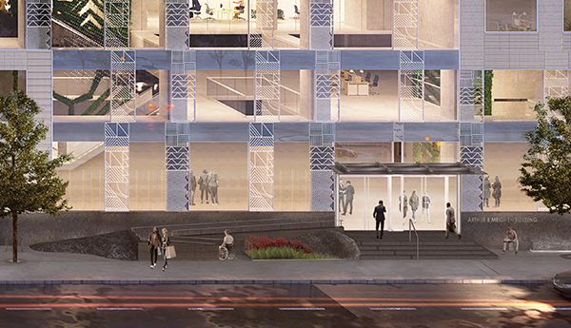








An accessible workspace for all
We are committed to ensuring barrier-free access to our federal buildings and workspaces.
By continuing to make our workplaces accessible and inclusive, we are moving towards the goal of making PSPC's workplace fully accessible by 2040.
Highlights:
Integrated assistive listening systems
Electric ice-melting system built right into the concrete sidewalk so that pedestrians can travel safely outside

Slide 14

The importance of reconciliation
We are advancing reconciliation through a holistic approach of meaningful consultation and building stronger relationships and strategic partnerships with Indigenous peoples.
Highlights:
Indigenous Services has offered part of their office space to be used as a GCcoworking site
Eight other departments are in that same area, potentially increasing Indigenous employment withint the Public Service
We created the Indigenous Design Guidelines to reflect and support the integration of Indigenous culture and perspectives in our work spaces

Slide 15

Conclusion
We will build on our successes throughout the pandemic and share timely communications in various ways with departments and agencies, as well as with PSPC employees.
We will carry forward lessons learned from PSPC hybrid workplace initiatives and pilots.
We will maintain two-way, targeted, clear and consistent communications with client departments and agencies.
We will keep advancing and supporting the gradual shift toward new ways of working.

Slide 16

Questions?
Thank you!

